Slide 1
Introduction to Supervised Machine Learning: Classification
MC. Luis Angel Galaviz Alejos
MS. Luis Angel Galaviz Alejos

Slide 2
Introduction

Slide 3




Artificial Intelligence

Slide 4














Data Science end to end
Get data
Build Model
Deploy Model

Slide 5
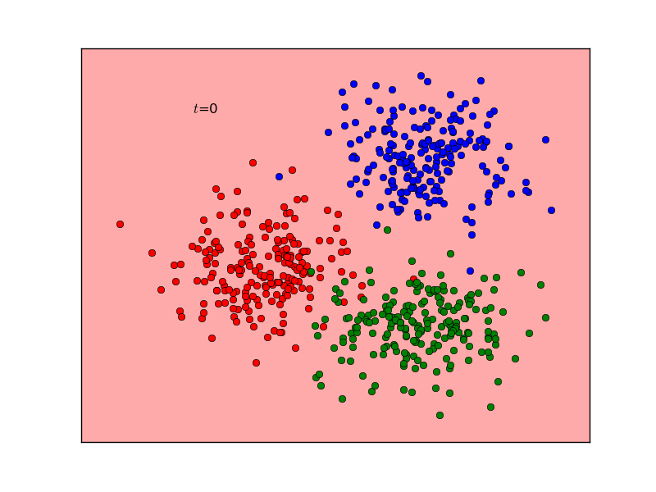
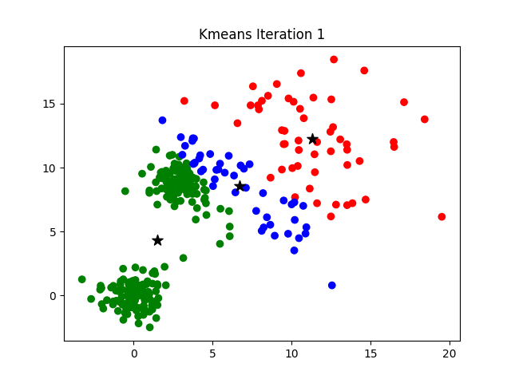

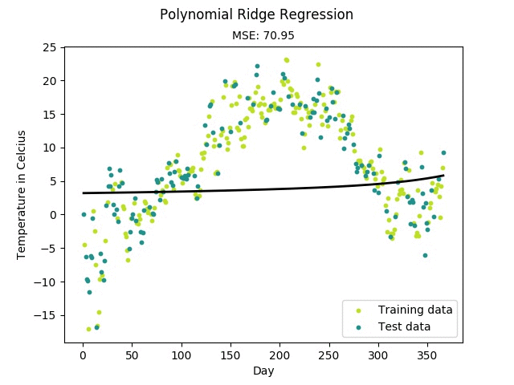
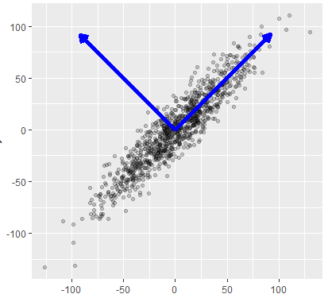
Machine Learning Types
Supervised
Unsupervised
Reinforced
Classification
Regression

Slide 6
Setup
1. Install Python Anaconda
2. Open Spyder by your OS file explorer

Slide 7
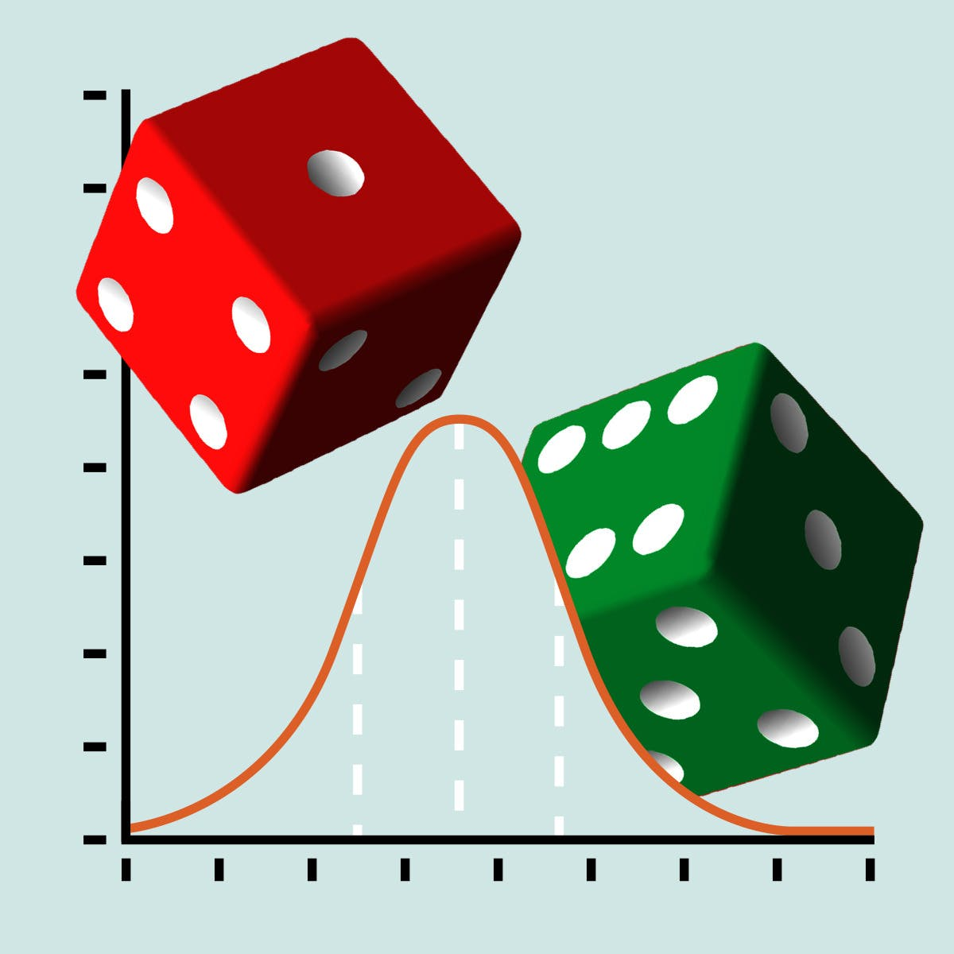


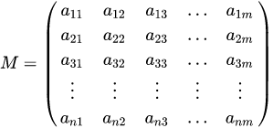
Theorical Pillars of Machine Learning

Slide 8
Probability Refresher

Slide 9
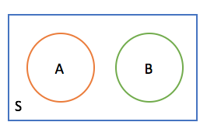
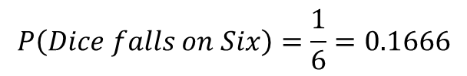
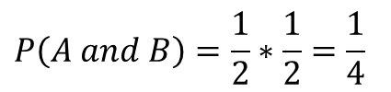
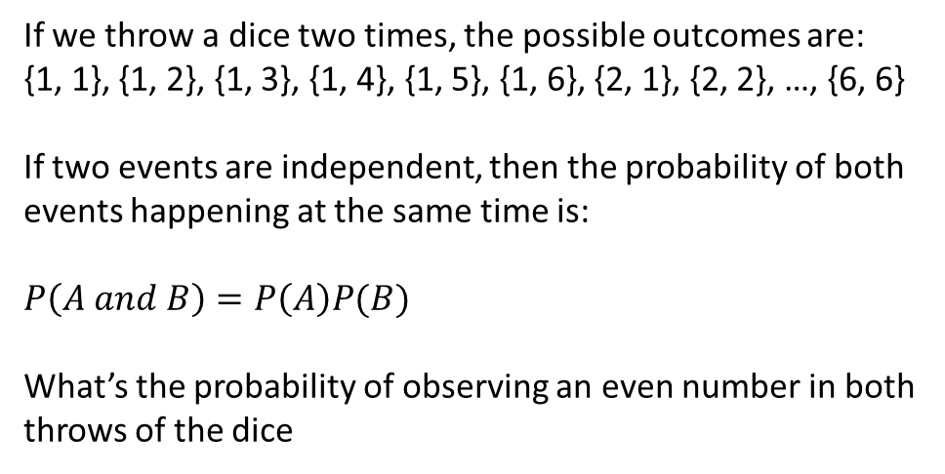
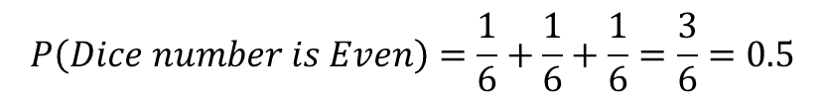
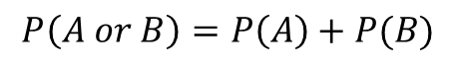
Probability Refresher: Independent Events
Event: Outcome of an experiment
Probability: A numerical description of how likely is an event to occur. $Probability of A=\frac{Number of times A is observed}{Total Observations}$
If we throw a dice, what’s the probability of observing a 6?
If we throw a dice two times, the possible outcomes are:
{1, 1}, {1, 2}, {1, 3}, {1, 4}, {1, 5}, {1, 6}, {2, 1}, {2, 2}, …, {6, 6}
If two events are independent, then the probability of both events happening at the same time is:
$$P\left(A and B\right)=P\left(A\right)P(B)$$
What’s the probability of observing an even number in both throws of the dice
$$P\left(Dice falls on Six\right)=\frac{1}{6}=0.1666$$
If events are independent then the probability of A or B:
$$P\left(A or B\right)=P\left(A\right)+P(B)$$
If we throw a dice, what’s the probability of observing an
even number? (Two or Four or Seven)
$$P\left(Dice number is Even\right)=\frac{1}{6}+\frac{1}{6}+\frac{1}{6}=\frac{3}{6}=0.5$$
$$P\left(A and B\right)=\frac{1}{2}∗\frac{1}{2}=\frac{1}{4}$$
Two events A and B are independent if A occurring doesn’t change the probability of B and vice versa
https://math.stackexchange.com/questions/2021474/which-of-these-event-can-be-represented-in-either-a-venn-diagram-and-tree-diagra

Slide 10
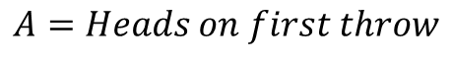
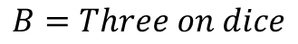
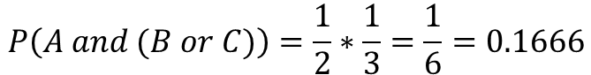
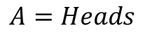
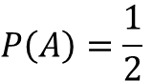
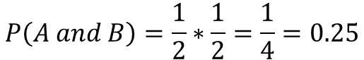
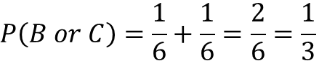
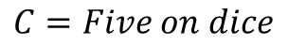
Probability Refresher: Independent Event Problems
You toss two times. What’s the probability of getting Heads on both throws?
$$A=Heads on first throw$$
$$P\left(A and B\right)=\frac{1}{2}∗\frac{1}{2}=\frac{1}{4}=0.25$$
$$A=Heads on second throw$$
You toss a coin and a dice. What’s the probability of observing a Heads on the coin and a three or a five on the dice?
$$A=Heads$$
$$P\left(A\right)=\frac{1}{2}$$
$$P\left(A and (B or C)\right)=\frac{1}{2}∗\frac{1}{3}=\frac{1}{6}=0.1666$$
$$B=Three on dice$$
$$P\left(B or C\right)=\frac{1}{6}+\frac{1}{6}=\frac{2}{6}=\frac{1}{3}$$
$$C=Five on dice$$

Slide 11
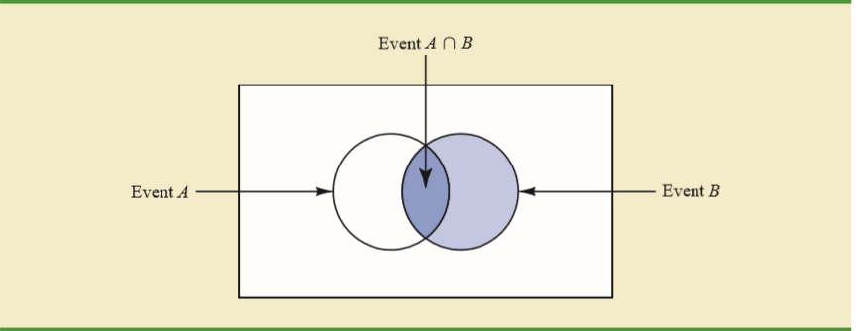
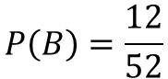
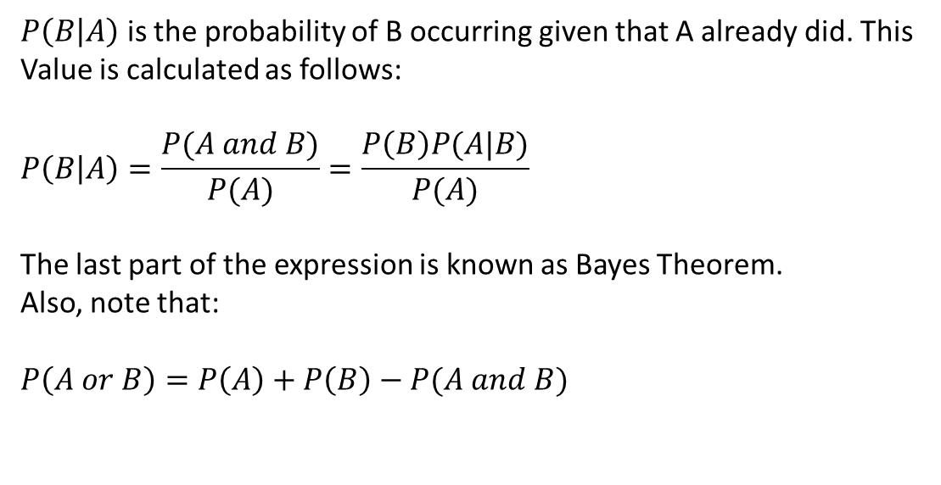
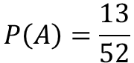
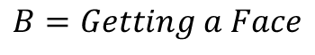
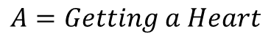
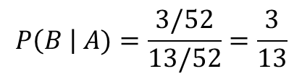
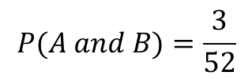
Probability Refresher: Dependent Events and Conditional Probability
The probability of two dependence events occurring at the same time is:
$$P\left(A and B\right)=P\left(A\right)P\left(B | A\right)=P\left(B\right)P(A|B)$$
$P\left(B | A\right)$ is the probability of B occurring given that A already did. This
Value is calculated as follows:
$$P\left(B | A\right)=\frac{P(A and B)}{P(A)}=\frac{P\left(B\right)P(A|B)}{P(A)}$$
The last part of the expression is known as Bayes Theorem.
Also, note that:
$$P\left(A or B\right)=P\left(A\right)+P\left(B\right)−P(A and B)$$
Two events A and B are dependent if A occurring modify the probability of B. For example, suppose you draw a card from one cards from a deck without replacement. You get a heart card, what’s the probability it is a face card?
$$A=Getting a Heart$$
$$P\left(A\right)=\frac{13}{52}$$
$$P(A and B)=\frac{3}{52}$$
$$P\left(B \right| A)=\frac{3/52}{13/52}=\frac{3}{13}$$
$$B=Getting a Face$$
$$P\left(B\right)=\frac{12}{52}$$
https://stats.stackexchange.com/questions/326253/what-is-the-intuition-behind-the-formula-for-conditional-probability/326292

Slide 12
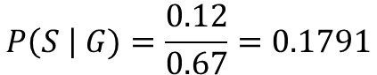
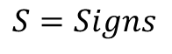
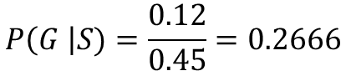
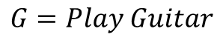
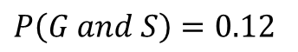
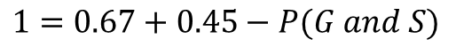
Probability Refresher: Dependent Events Problems
There are 100 persons in a music school, 67 persons play guitar, 45 persons sing. Which is the probability that it plays the guitar and sings?
$$P\left(G or S\right)=P\left(G\right)+P\left(S\right)−P(G and S)$$
$$G=Play Guitar$$
$$1=0.67+0.45−P(G and S)$$
$$S=Signs$$
$$P\left(G and S\right)=0.12$$
What’s the probability of that a person that plays the Guitar sing? What’s the probability a person that signs plays the guitar?
$$P\left(G \right|S)=\frac{0.12}{0.45}=0.2666$$
$$P\left(S \right| G)=\frac{0.12}{0.67}=0.1791$$

Slide 13
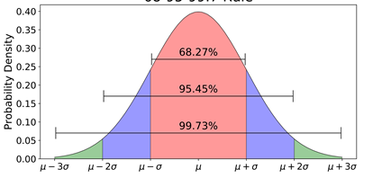
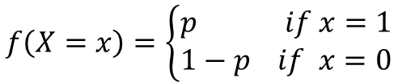
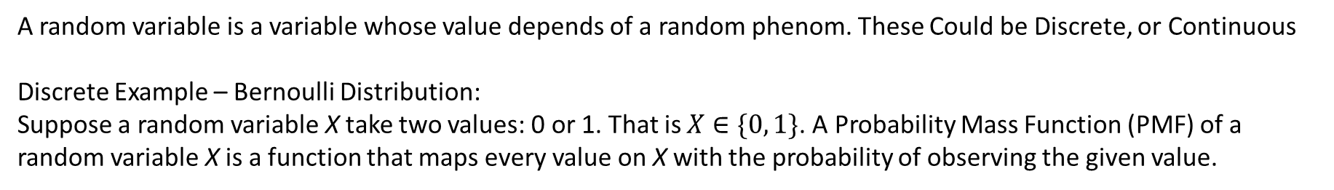
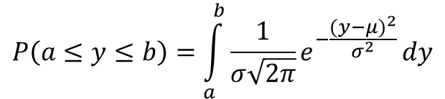
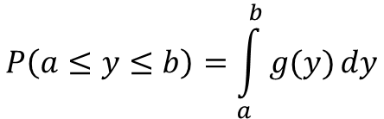
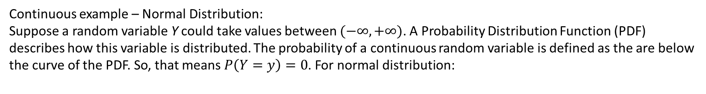
Probability Refresher: Random Variables, Bernoulli Distribution
A random variable is a variable whose value depends of a random phenom. These Could be Discrete, or Continuous
Discrete Example – Bernoulli Distribution:
Suppose a random variable X take two values: 0 or 1. That is $X∈\{0, 1\}$. A Probability Mass Function (PMF) of a random variable X is a function that maps every value on X with the probability of observing the given value.
$$f\left(X=x\right)=\left\{\begin{aligned}p if x=1 \\ 1−p if x=0\end{aligned}\right.$$
Continuous example – Normal Distribution:
Suppose a random variable Y could take values between $(−∞, +∞)$. A Probability Distribution Function (PDF) describes how this variable is distributed. The probability of a continuous random variable is defined as the are below the curve of the PDF. So, that means $P\left(Y=y\right)=0$. For normal distribution:
$$P\left(a≤y≤b\right)=\int_{a}^{b}{g(y)}dy$$
$$P\left(a≤y≤b\right)=\int_{a}^{b}{\frac{1}{σ\sqrt{2π}}e^{−\frac{{(y−μ)}^{2}}{σ^{2}}}}dy$$
https://towardsdatascience.com/understanding-the-68-95-99-7-rule-for-a-normal-distribution-b7b7cbf760c2

Slide 14
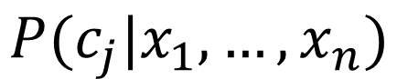
What classification is about?
We have a set of input variables $x_{1},…,x_{n}$ where n is the number of input variables. And $c_{1},…,c_{m}$ classes. We want to find:
$$P(c_{j}|x_{1},…,x_{n})$$
Examples:
Determine if a person has a diabetes, given his sugar levels in blood, weight and age
Determine if a person will pay a credit, given his salary and account balance
Determine if an email is spam, given the words it contains

Slide 15
Classification with Discrete Predictors (PD)

Slide 16
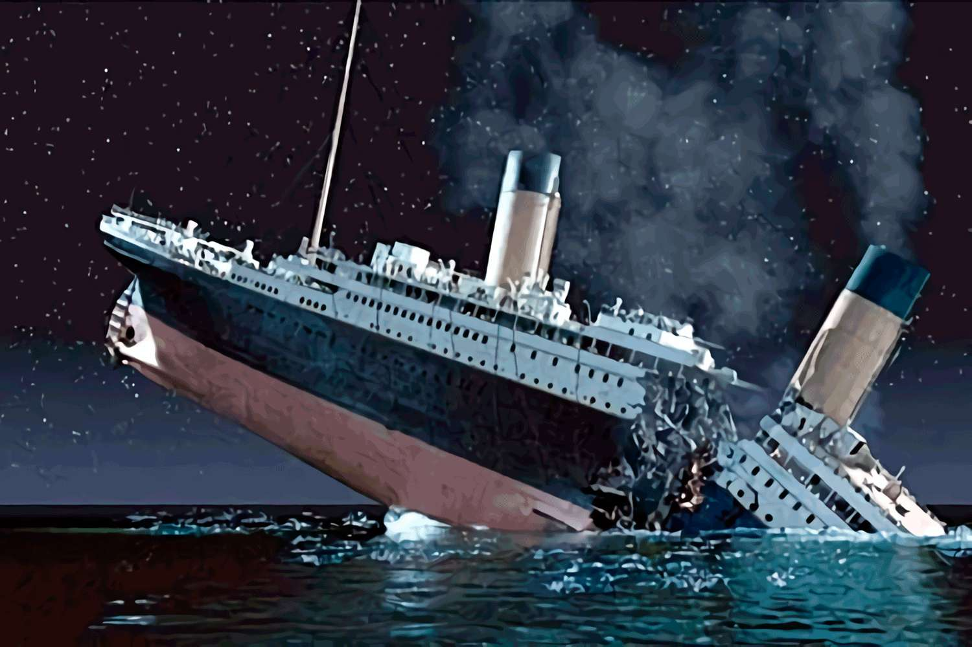
Classification D.P.: Titanic Dataset
Variable | Definition | Key
survival | Survival | 0 = No, 1 = Yes
pclass | Ticket class | 1 = 1st, 2 = 2nd, 3 = 3rd
sex | Sex
Age | Age in years
sibsp | # of siblings / spouses aboard the Titanic
parch | # of parents / children aboard the Titanic
ticket | Ticket number
fare | Passenger fare
cabin | Cabin number
embarked | Port of Embarkation | C = Cherbourg, Q = Queenstown, S = Southampton
https://www.kaggle.com/c/titanic

Slide 17
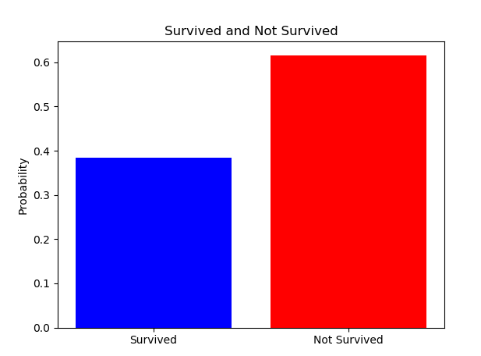
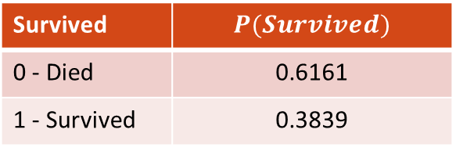
Classification (DP): Solving Titanic Dataset Using Bayes W/O Predictors
We begin with calculating the probability of Survive independently of any predictor variable. We get the following table (Knowledge Base)
Survived | $$P(Survived)$$
0 - Died | 0.6161
1 - Survived | 0.3839
Interesting enough, we can say everyone died and we will be right 61.61% (Accuracy) of the times on the train set. Could this be acceptable?
https://www.kaggle.com/c/titanic

Slide 18
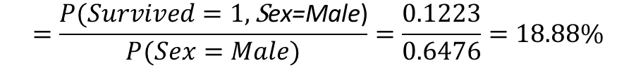

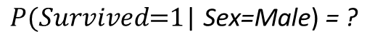
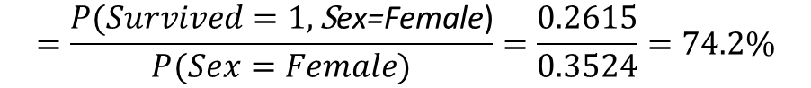
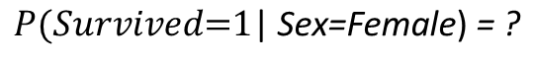
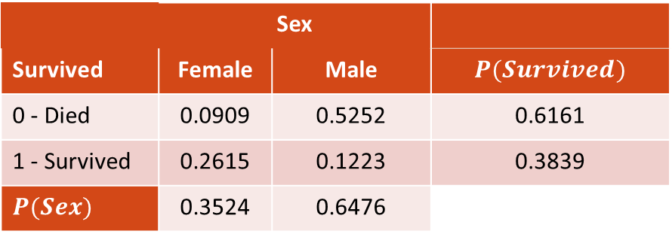
Classification (DP): Solving Titanic Dataset Using Bayes, One Predictor (Sex)
We will now continue with creating one model that considers if the passenger Survive given his Sex. That is $P(Survived\text{|} \text{Sex}\text{)}$, we get the following joint distribution table as knowledge base
 | Sex
Survived | Female | Male | $$P(Survived)$$
0 - Died | 0.0909 | 0.5252 | 0.6161
1 - Survived | 0.2615 | 0.1223 | 0.3839
$$P(Sex)$$ | 0.3524 | 0.6476
$$P(Survived\text{=1}\text{|} \text{Sex}\text{=}\text{Female}\text{)}\text{ = ?}$$
$$=\frac{P(Survived=1,\text{S}\text{ex}\text{=}\text{Female}\text{)}}{P(Sex=Female)}=\frac{0.2615}{0.3524}=74.2\%$$
$$P(Survived\text{=1}\text{|} \text{Sex}\text{=}\text{Male}\text{)}\text{ = ?}$$
This table contains the probability of the intersection of events on the center cells, on the edges we have the marginal probabilities of each variable. With this we can calculate the conditional probabilities.
$$=\frac{P(Survived=1,\text{S}\text{ex}\text{=}\text{M}\text{ale}\text{)}}{P(Sex=Male)}=\frac{0.1223}{0.6476}=18.88\%$$
https://www.kaggle.com/c/titanic

Slide 19
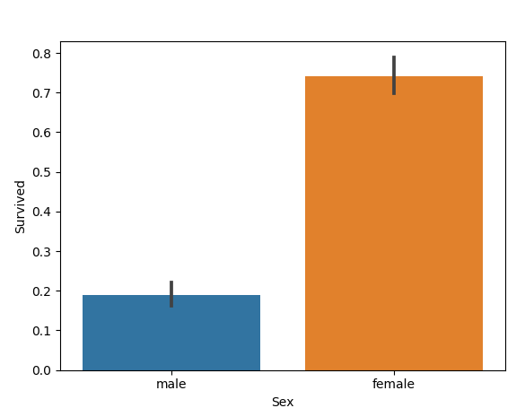


Classification (DP): Solving Titanic Dataset Using Bayes, One Predictor
$$P(Survived\text{=1}\text{|} \text{Sex}\text{=}\text{Female}\text{)}\text{ = 74.2\%}$$
$$P(Survived\text{=1}\text{|} \text{Sex}\text{=}\text{Male}\text{)}\text{ = 18.88\%}$$
We can create one model that says if passenger is female he survived, if passenger is a men he died. With this we should achieve 78.67%. Can you see why?
https://www.kaggle.com/c/titanic

Slide 20







Classification (DP): Solving Titanic Dataset Using Bayes, One Predictor (Pclass)
We will now try with creating a model that considers if the passenger Survive given his Pclass. That is $P(Survived\text{|} \text{Pclass}\text{)}$, we get the following knowledge base
 | Pclass
Survived | 1st | 2nd | 3rd | $$P(Survived)$$
0 - Died | 0.0897 | 0.1088 | 0.4175 | 0.6161
1 - Survived | 0.1526 | 0.0976 | 0.1335 | 0.3839
$$P(Pclass)$$ | 0.2424 | 0.2065 | 0.5510
$$P(Survived\text{=1}\text{|} \text{Pclass}\text{=1}\text{st}\text{)}\text{ = ?}$$
$$=\frac{P(Survived=1,\text{Pclass}\text{=}\text{1}\text{st}\text{)}}{P(Pclass=1st)}=\frac{0.1526}{0.2424}=62.95\%$$
$$P(Survived\text{=1}\text{|} \text{Pclass}\text{=2}\text{nd}\text{)}\text{ = ?}$$
$$=\frac{P(Survived=1,\text{Pclass}\text{=}\text{2}\text{nd}\text{)}}{P(Pclass=2nd)}=\frac{0.0976}{0.2065}=47.26\%$$
This table contains the probability of the intersection of events on the center cells, on the edges we have the marginal probabilities of each variable. With this we can calculate the conditional probabilities.
$$P(Survived\text{=1}\text{|} \text{Pclass}\text{=3}\text{rd}\text{)}\text{ = ?}$$
$$=\frac{P(Survived=1,\text{Pclass}\text{=}\text{3}\text{d}\text{)}}{P(Pclass=3d)}=\frac{0.1335}{0.5510}=24.22\%$$
https://www.kaggle.com/c/titanic

Slide 21




Classification (DP): Solving Titanic Dataset Using Bayes, One Predictor (Pclass)
$$\frac{P(Survived=1,\text{Pclass}\text{=}\text{1}\text{st}\text{)}}{P(Pclass=1st)}=62.95\%$$
$$\frac{P(Survived=1,\text{Pclass}\text{=}\text{2}\text{nd}\text{)}}{P(Pclass=2nd)}=47.26\%$$
$$\frac{P(Survived=1,\text{Pclass}\text{=}\text{3}\text{d}\text{)}}{P(Pclass=3d)}=24.22\%$$
We can create one model that says if passenger is first class he survived, otherwise he died. With this we should achieve 67.89%. Can you see why?
https://www.kaggle.com/c/titanic

Slide 22





Classification (DP): Solving Titanic Dataset Using Bayes, Two Predictors (Pclass,Sex)
We will now try with creating a model that considers if the passenger Survive given two variables Pclass and Sex. That is $P(Survived\text{|} \text{Pclass}, Sex\text{)}$, we get the following knowledge base
Sex | Female |  |  | Male
 | Pclass |  |  | Pclass
Survived | 1st | 2nd | 3rd | 1st | 2nd | 3rd
0 - Died | 0.0033 | 0.0067 | 0.0808 | 0.0864 | 0.1021 | 0.3367
1 - Survived | 0.1021 | 0.0785 | 0.0808 | 0.0505 | 0.0190 | 0.0527
$$P(Survived\text{=1}\text{|} \text{Sex}\text{=}\text{Female}\text{, }\text{Pclass}\text{=1}\text{st}\text{)}\text{ = ?}$$
$$P(Survived\text{=1}\text{|} \text{Sex}\text{=}\text{Female}\text{, }\text{Pclass}\text{=3}\text{rd}\text{)}\text{ = ?}$$
$$=\frac{P(Survived=1,\text{Sex}\text{=}\text{Female}\text{, }\text{Pclass}\text{=}\text{1}\text{st}\text{)}}{P(Pclass=1st,Sex=Female)}$$
$$=\frac{P(Survived=1,\text{Sex}\text{=}\text{Female}\text{, }\text{Pclass}\text{=}\text{3}\text{rd}\text{)}}{P(Pclass=3rd,Sex=Female)}$$
$$=\frac{0.1021}{0.1021+0.0033}=96.86\%$$
$$=\frac{0.0808}{0.0808+0.0808}=50.00\%$$
https://www.kaggle.com/c/titanic

Slide 23

Classification (DP): Solving Titanic Dataset Using Bayes, Two Predictors (Pclass,Sex)
https://www.kaggle.com/c/titanic

Slide 24




Comparing Classifiers: Confusion Matrix Definition
 | $$\hat{Y}= 0$$ | $$\hat{Y} = 1$$
$$Y=0$$ | True Negative (TN) | False Positive (FP)
$$Y=1$$ | False Negative (FN) | True Positive (TP)
$$Accuracy= \frac{TP+TN}{TP+TN+FN+FP}$$
$$Sensitivity= \frac{TP}{TP+FN}$$
$$Specificity= \frac{TN}{TN+FP}$$
TN: Instances your model predicted to belong to class 0, and in fact belonged to class 0
FN: Instances your model predicted to belong to class 0, but they really belonged to class 1
FP: Instances your model predicted to belong to class 1, but they really belonged to class 0
TP: Instances your model predicted to belong to class 1, and in fact belonged to class 1
Accuracy is the rate of correctly classified instances
Sensitivity is the rate of positives correctly classified
Specificity is the rate of negatives correctly classified
Observe that on titanic dataset we could get an accuracy of 61.61% by stating everyone died. However we would get 0% sensitivity
Which metric you should use depends on the application domain
https://en.wikipedia.org/wiki/Confusion_matrix

Slide 25












Comparing Classifiers: Classifiers comparison (Test Set)
$$P(Survived|Sex)$$
151 | 24
36 | 84
$$P(Survived|Pclass)$$
150 | 25
64 | 56
$$P(Survived|Pclass,Sex)$$
170 | 5
62 | 58
$$Accuracy= \frac{151+84}{151+84+36+24}=79.66\%$$
$$Accuracy=69.38\%$$
$$Accuracy=77.28\%$$
$$Sensitivity=46.66\%$$
$$Sensitivity=48.33\%$$
$$Sensitivity= \frac{84}{36+84}=70.00\%$$
$$Specificity=85.71\%$$
$$Specificity=97.14\%$$
$$Specificity= \frac{151}{151+24}=86.28\%$$

Slide 26



Naïve Bayes: Simplifying things
In General a Bayesian model would be $P(\text{C} \text{|} \text{X}\text{)}$. Let $n$ be the number of predictor variables and $m$ the number of target classes, then ${X=\{x}_{1},…,x_{i},…,x_{n}\}$ is the set of predictor variables and
$C=\{c_{1},..,c_{j},…,c_{m}\}$ is the set of target classes. Is the set of response variables. Can you see what is the problem with this?
Problem is that joint probability table grows exponentially on the number of variables. If we suppose every $x_{i}$ have the same number of possible values it would grow $\left|C\right|{|X|}^{n}$ , for example if $\left|C\right|=2,$
$\left|X\right|=2, n=50$ then the table would have 2,251,799,813,685,248 cells. Is there a solution?
Solution is to consider that every $x_{i}$ to be conditionally independent to $c_{j}$. That is for every $k$ and $l$ such that $0≤k≤n, 0≤l≤n and k ≠l$ , $P\left(x_{k} | x_{l},c_{j}\right)=P(x_{k}|c_{j})$. In other words, no element of $X$ would give us any information about the probability of another $X$ element. For example, on Titanic Dataset Pclass would not give any information about the sex of the person. This allows to only do linear calculations on the number of variables!
https://en.wikipedia.org/wiki/Naive_Bayes_classifier

Slide 27



Naïve Bayes: Definition
p$\left(c_{j}\right| x_{1},…,x_{n})= \frac{p\left(x_{1},…,x_{n}\right|c_{j})p(c_{j})}{p\left(x_{1},…,x_{n}\right)}=\frac{p(x_{1},..,x_{n},c_{j})}{p\left(x_{1},…,x_{n}\right)}$
Applying chain rule of conditional probability
If every X element is conditional independent to $c_{j}$
Which greatly simplifies our model
p$\left(c_{j}\right| x_{1},…,x_{n})= \frac{p(c_{j})\prod_{i=1}^{n}{p(x_{i}|c_{j})}}{p\left(x_{1},…,x_{n}\right)}$

Slide 28

Naïve Bayes: Titanic Example
We calculate the conditional probability table for every variable. Note that these are a different kind of tables to the ones we did on the past examples (joint probability tables)
 |  | Died | Survived
Sex | Female | 0.1524 | 0.6711
 | Male | 0.8475 | 0.3288
$$Pclass= 1st and Sex = female$$
$$p\left(Survived\right)\prod_{i=1}^{n}{p\left(x_{i} | Survived\right)}=0.3725∗0.6711∗0.3603$$
$$=0.0900$$
$$p\left(Died\right)\prod_{i=1}^{n}{p\left(x_{i} | Died\right)}=0.6275∗0.1524∗0.147=0.0140$$
$$p\left(Survived| X\right)=\frac{0.0900}{0.0900+0.0140}=86.53\%$$
$$p\left(Died| X\right)=\frac{0.0140}{0.0900+0.0140}=13.47\%$$
 |  | Died | Survived
Pclass | 1 | 0.1470 | 0.3603
 | 2 | 0.1711 | 0.2747
 | 3 | 0.6818 | 0.3648
P(Died) | P(Survived)
0.6275 | 0.3725
https://www.analyticsvidhya.com/blog/2017/09/naive-bayes-explained/

Slide 29



Naïve Bayes: Properties
Advantages:
Works good with small amounts of data
Is fast
Easy to scale in the number of variables
Handles continuous and discrete data
Even if the NB assumption doesn’t hold, it works great in practice
Disadvantages:
The strong assumption about the features to be independent which is hardly true in real life applications
Is considered a good classifier but a bad estimator, so the probabilities it predicts shouldn’t be taken so seriously

Slide 30
Logistic Regression (Binary classification)

Slide 31


Logistic Regression: Odds
To understand logistic regressions we should first understand odds concept. Odds is term used in gambling which reflect the chances of winning a bet versus the chances of loosing it
$$odds=\frac{Winning events}{Loosing events}$$
$$= \frac{probability of winning}{probability of loosing}=\frac{p}{1−p}$$
$$odds→(0, +∞)$$
Sometimes the log of the odds is used because they had some nice properties for calculation
$$\log\left(odds\right)=ln⁡(\frac{p}{1−p})$$
$$\log\left(odds\right)→(−∞, +∞)$$
Note that odds are not probabilities
Winning | Loosing | $$odds$$ | $$\log\left(odds\right)$$
5 | 5 | 1 | 0
4 | 5 | 0.8 | -0.2231
5 | 4 | 1.25 | 0.2231
5 | 1 | 5 | 1.6094
1 | 5 | 0.2 | -1.6094
5 | 0 | $$+∞$$ | $$+∞$$
0 | 5 | 0 | $$−∞$$

Slide 32




Logistic Regression: Odds
$$odds=\frac{p}{1−p}$$
$$log⁡(odds)=ln⁡(\frac{p}{1−p})$$

Slide 33


Logistic Regression: Logit function, doing a linear relationship with log odds
Wouldn’t be nice if we could make a linear model between variables and probability ($β_{0}+β_{1}x_{1}+…+β_{n}x_{n}$)?
That’s not possible because probability goes is on the interval $[0, 1]$ and $β_{0}+β_{1}x_{1}+…+β_{n}x_{n}$ is on $(−∞, +∞)$
What about trying to do a linear relationship on the odds? Those vary between $[0, +∞)$ and a linear model varies between $\left(−∞, +∞\right)$, so this is not possible either
What about tying to do a linear relationship between our predictor and $\log\left(odds\right)$? That’s the way to go!
We end with the expression
$$\ln\left(\frac{p}{1−p}\right)=β_{0}+β_{1}x_{1}+…+β_{n}x_{n}$$

Slide 34


Logistic Regression: Logit function, solving for p
We are interested on probability, so let's solve for p
$$\frac{p}{1−p}=e^{β_{0}+β_{1}x_{1}+…+β_{n}x_{n}}$$
$$p=e^{β_{0}+β_{1}x_{1}+…+β_{n}x_{n}}\left(1−p\right)$$
$$p=e^{β_{0}+β_{1}x_{1}+…+β_{n}x_{n}}\left(−p\right)+e^{β_{0}+β_{1}x_{1}+…+β_{n}x_{n}}$$
$$p={−p(e}^{β_{0}+β_{1}x_{1}+…+β_{n}x_{n}})+e^{β_{0}+β_{1}x_{1}+…+β_{n}x_{n}}$$
$$p+{p(e}^{β_{0}+β_{1}x_{1}+…+β_{n}x_{n}})=e^{β_{0}+β_{1}x_{1}+…+β_{n}x_{n}}$$
$$p(1+e^{β_{0}+β_{1}x_{1}+…+β_{n}x_{n}})=e^{β_{0}+β_{1}x_{1}+…+β_{n}x_{n}}$$
$$p=\frac{e^{β_{0}+β_{1}x_{1}+…+β_{n}x_{n}}}{1+e^{β_{0}+β_{1}x_{1}+…+β_{n}x_{n}}}=\frac{1}{1+e^{−(β_{0}+β_{1}x_{1}+…+β_{n}x_{n})}}$$
This is called logistic function, represented by σ
https://en.wikipedia.org/wiki/Logistic_function

Slide 35





Logistic Regression: Maximum likelihood of Bernoulli distribution
We need a way to measure how well our curve is fitted to the data, for this we will need to understand what maximum likelihood is. If we want to do a classification for two classes, we would need a Bernoulli distribution. This models the probability of getting a binary random number $k ∈ \{0, 1\}$, where $p$ is the probability of observing a $1$ and $q = 1 − p$ is the probability of observing a $0$
$$f\left(k\right)=\left\{\begin{aligned}p if k=1 \\ 1−p if k=0\end{aligned}\right.$$
Suppose we throw a coin and we observe 7 heads (represented with ones) and 3 tails. Which is the value of p that maximizes the probability of getting those observations? This calculation is known as maximum likelihood and is done as follows.
$$f\left(p \right| 6 heads, 4 tails)=L=p^{7}{(1−p)}^{3}$$
$$\log\left(L\right)=ℓ=Ln\left(p^{7}{\left(1−p\right)}^{3}\right)$$
$$ℓ=Ln\left(p^{7}\right)+\text{Ln}{\left(1−p\right)}^{3}=7Ln\left(p\right)+\text{3}\text{Ln}\text{(1}−\text{p} \text{)}$$
We use the derivate to calculate the maximum
$$\frac{dl}{dp}=0=\frac{7}{p}−\frac{3}{1−p}$$
$$\frac{7}{p}=\frac{3}{1−p}$$
$$\frac{1−p}{p}=\frac{3}{7}$$
$$\frac{1}{p}=\frac{3}{7}+1$$
$$p=\frac{7}{10}$$

Slide 36




Logistic Regression: Maximum likelihood of Bernoulli distribution, Cross Entropy
The general formula to calculate the Maximum Likelihood of a Bernoulli Distribution is:
$$L=\prod_{i=1}^{m}{{\hat{y}}_{i}^{y_{i}}{(1−{\hat{y}}_{i})}^{1−y_{i}}}$$
$$Ln\left(L\right)=ℓ=\sum_{i=1}^{m}{y_{i}\operatorname{Ln}\left({\hat{y}}_{i}\right)+(1−}y_{i})Ln(1−{\hat{y}}_{i})$$
$$y_{i}$$ | $${\hat{y}}_{i}$$ | $$ℓ$$
0 | 0.2 | -0.2231
0 | 0 | 0
0 | 0.6 | -0.9163
0 | 0.3 | -0.3567
0 | 0.5 | -0.6931
1 | 0.8 | -0.2231
1 | 0.1 | -2.3026
1 | 1 | 0
1 | 0.65 | -0.4308
1 | 0.3 | -1.2040
$$Where: \\ m=Number of observations$$
$$y_{i}=Value of y on observation i$$
$${\hat{y}}_{i}=Value of y predicted by your model on observation i$$
$−ℓ$ is know as Cross Entropy Error, this is the function we will
Use to evaluate how good or classification is, the less this function
Is the better

Slide 37


Logistic Regression: Two examples of decision boundary with Cross Entropy Error

Slide 38










Logistic Regression: Fitting the curve
So now, we have a logistic function and we are searching for the weights of the odds that do minimizes the Cross Entropy Error
$$J=−\sum_{i=1}^{m}{y_{i}\operatorname{Ln}\left({\hat{y}}_{i}\right)+(1−}y_{i})Ln(1−{\hat{y}}_{i})$$
$$\hat{y} \text{= }\text{σ}\text{(}x_{1},…,x_{n})=\frac{1}{1+e^{−(β_{0}+β_{1}x_{1}+…+β_{n}x_{n})}}$$
Now we need to take the derivative of $J$ to solve for coefficients $β_{0},…,β_{n}$
$$\frac{\text{∂}\text{J}}{\text{∂}β_{j}}=\sum_{i=1}^{m}{\frac{\text{∂}\text{J}}{\text{∂}{\hat{y}}_{i}}\frac{\text{∂}{\hat{y}}_{i}}{{\text{∂}a}_{i}}\frac{\text{∂}a_{i}}{{\text{∂}β}_{j}}}$$
$a_{i}=$ $βX_{i}$
$$\frac{\text{∂}{\hat{y}}_{i}}{{\text{∂}a}_{i}}=\frac{e^{−a_{i}}}{{(1+e^{−a_{i}})}^{2}}=$$
$\frac{1}{1+e^{−a_{i}}}\frac{e^{−a_{i}}}{1+e^{−a_{i}}}=$ ${\hat{y}}_{i}(1−{\hat{y}}_{i})$
$$\frac{\text{∂}\text{J}}{\text{∂}β_{j}}=−\sum_{i=1}^{m}{y_{i}\frac{{\hat{y}}_{i}(1−{\hat{y}}_{i})X_{ij}}{{\hat{y}}_{i}}−(1−y_{i})\frac{{\hat{y}}_{i}(1−{\hat{y}}_{i})X_{ij}}{1−{\hat{y}}_{i}}}$$
$$\frac{\text{∂}\text{J}}{\text{∂}β_{j}}=\sum_{i=1}^{m}{({\hat{y}}_{i}−}y_{i})X_{ij}$$
$$\frac{\text{∂}\text{J}}{\text{∂}β}=\sum_{i=1}^{m}{({\hat{y}}_{i}−}y_{i})X_{i}$$
$$\frac{\text{∂}\text{J}}{\text{∂}{\hat{y}}_{i}}=−[y_{i}\frac{1}{{\hat{y}}_{i}}+\left(1−y_{i}\right)\frac{1}{1−{\hat{y}}_{i}}\left(−1\right)]$$
$$\frac{\text{∂}a_{i}}{{\text{∂}β}_{j}}=X_{ij}$$
$$\frac{\text{∂}\text{J}}{\text{∂}β}=X^{T}(Y−T)$$

Slide 39


Logistic Regression: Gradient Descent
Supposse we want to find:
$${argmin}_{x}f(x)$$
That is, an x value which give us the minimum value for $f(x)$. Gradient descent achieve this by initializing $x$ to a random value and iteratively taking small steps towards the opposite direction of $f^{′}(x)$ (Recall that $f^{′}(x)$ points toward the maximum value of $f(x)$). That is:
$$x_{i+1}=x_{i}−γf^{′}(x)$$
Where:
$$x_{i}:x value on iteration i$$
$$x_{i+1}:x value on iteration i+1$$
$γ:Learning rate$

Slide 40

Logistic Regression: Results

Slide 41
Logistic Regression: Properties
Advantages:
Computationally efficient
Very interpretable
Unlikely to overfit
Disadvantages:
Can only classify linearly separable data

Slide 42
KNN

Slide 43

KNN: Intuition
https://www.udemy.com/course/data-science-logistic-regression-in-python/

Slide 44


KNN: Gaussian Clouds

Slide 45
KNN: Properties
Advantages:
No training time
New data can be added without retrain
Easy to implement
Disadvantages:
Do not work well with large datasets
Do not work well with a lot of dimensions
Need inputs to be on same scale
https://www.fromthegenesis.com/pros-and-cons-of-k-nearest-neighbors/

